Slide 1
Lecture No 2: Working with Variables, Operators & Expressions
Muhammad Siddique

Slide 2
Outline
Understand statements, identifiers, and keywords
Use variables to store information.
Work with primitive data types.
Use arithmetic operators such as the plus sign (+) and the minus sign (–).
Increment and decrement variables.

Slide 3
Understanding statements
Statements in C# follow a well-defined set of rules describing their format and construction.
These rules are collectively known as syntax.
One of the simplest and most important C# syntax rules states that you must terminate all statements with a semicolon.
For Example, Console.WriteLine("Hello, World!");

Slide 4
Using identifiers
Identifiers are the names that you use to identify the elements in your programs, such as namespaces, classes, methods, and variables.
You can use only letters (uppercase and lowercase), digits, and underscore characters.
An identifier must start with a letter or an underscore.
For example, result, _score, footballTeam, and plan 9 are all valid identifiers, whereas result %, footballTeam$, and 9plan are not.
Important Note: C# is a case-sensitive language: footballTeam and FootballTeam are two different identifiers.

Slide 5
Identifying keywords
The C# language reserves 77 identifiers for its own use, and you cannot reuse these identifiers for your own purposes.
These identifiers are called keywords, and each has a particular meaning.
Examples of keywords are class, namespace, and using.

Slide 6
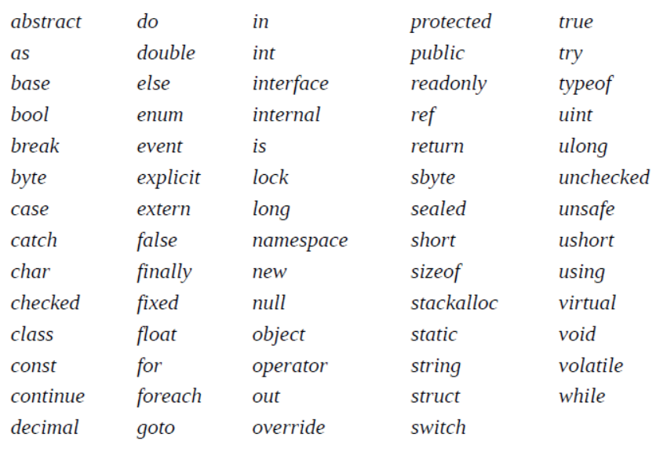
Identifying keywords

Slide 7
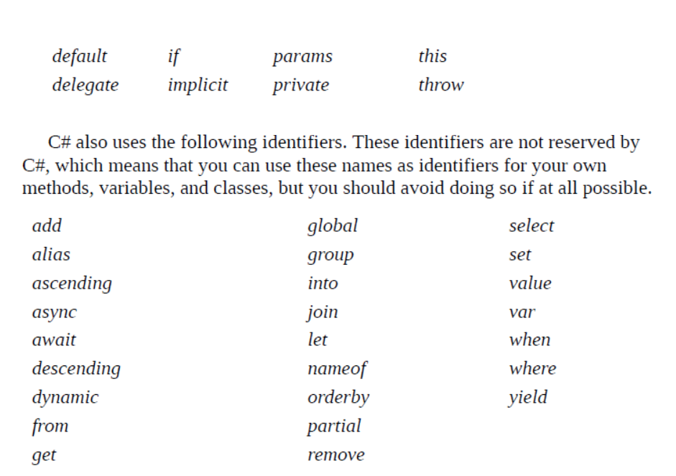
Identifying keywords

Slide 8
Constants & Literals
Integer Literals
An integer literal can be a decimal, or hexadecimal constant.
For Example
212
215u
0xFeeL

Slide 9
Constants & Literals
Floating Literals
An Floating literal can be a decimal, or hexadecimal constant.
For Example
212 .3333
21522-5F

Slide 10
Constants & Literals
Character Constants
Character literals are enclosed in single quotes.
For example, 'x' and can be stored in a simple variable of char type.
A character literal can be a plain character (such as 'x'), an escape sequence (such as '\t'), or a universal character (such as '\u02C0').

Slide 11
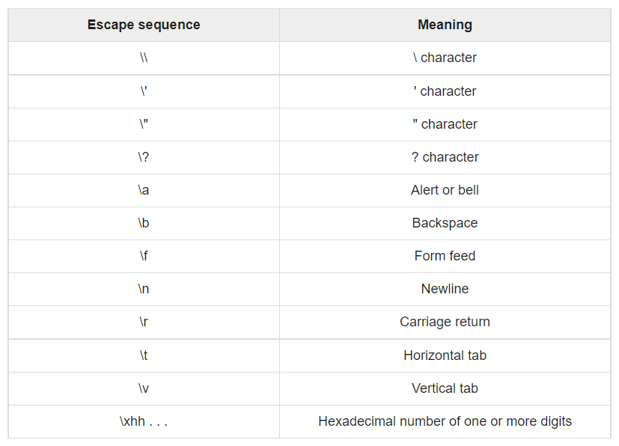
Character Constants

Slide 12
Working with Primitive Data Types
The numeric types of C#, together with other common types for holding strings, characters, and Boolean values, are collectively known as the primitive data types.
The following table lists the most commonly used primitive data types and the range of values that you can store in each.

Slide 13
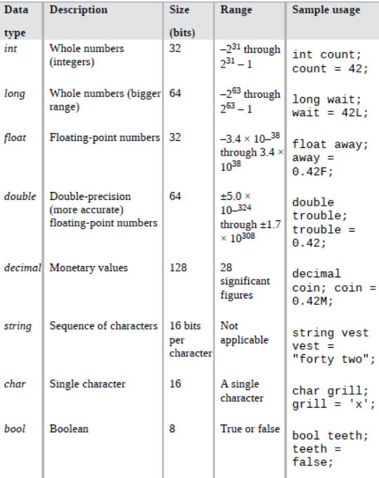
Working with Primitive Data Types

Slide 14
Operators
An operator is a symbol that tells the compiler to perform specific mathematical or logical manipulations.
C# has rich set of built-in operators and provides the following type of operators
Arithmetic Operators
Relational Operators
Logical Operators
Bitwise Operators
Assignment Operators
Misc Operators

Slide 15
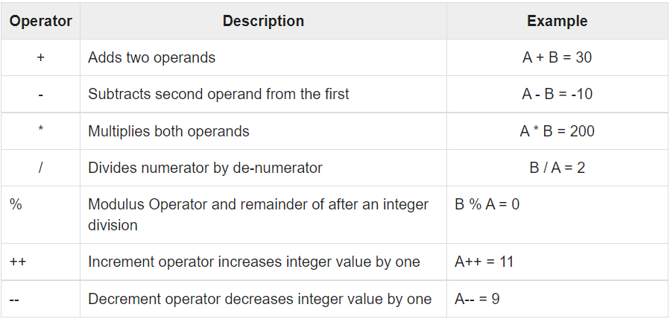
Arithmetic Operators

Slide 16
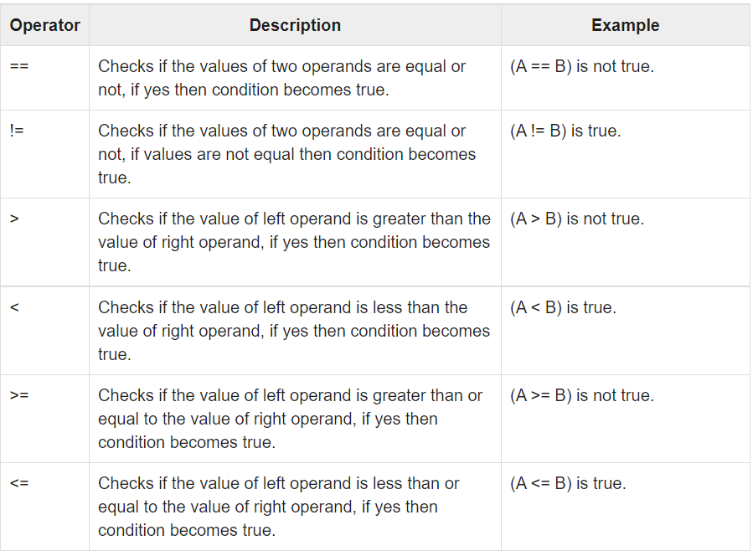
Relational Operators

Slide 17
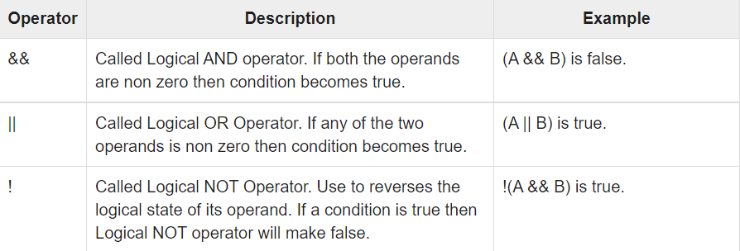
Logical Operators

Slide 18
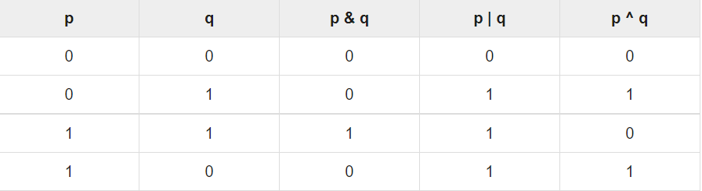
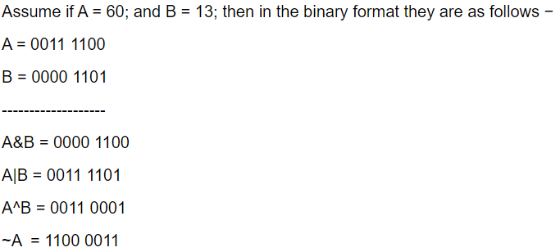
Bitwise Operators (I)

Slide 19
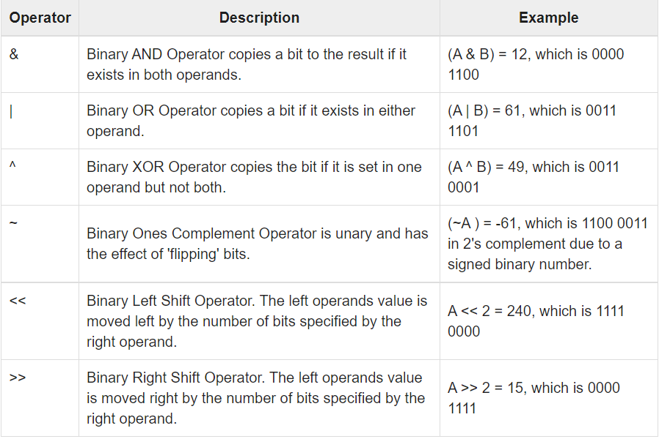
Bitwise Operators (II)

Slide 20
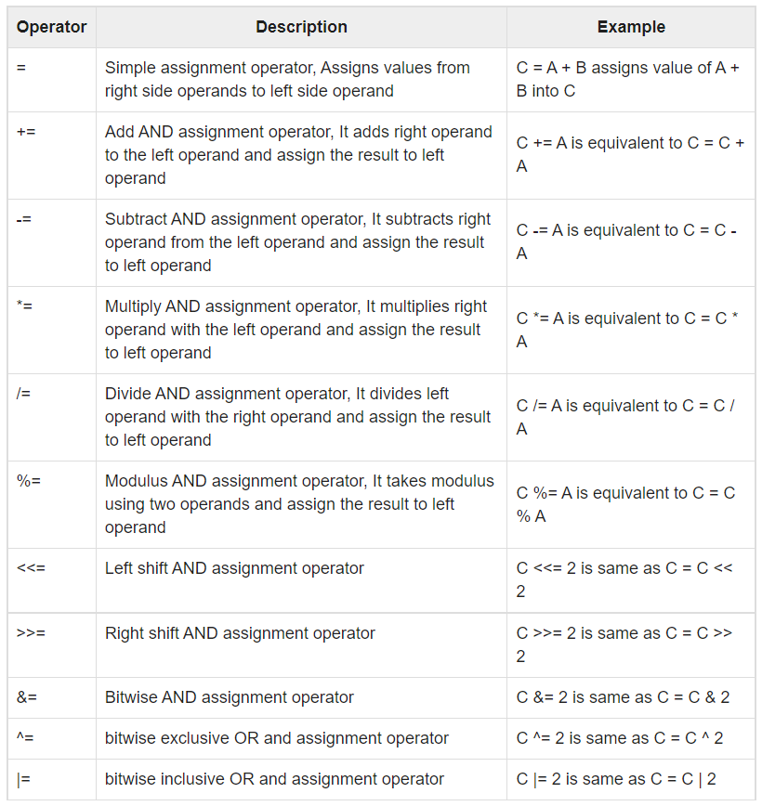
Assignment Operators

Slide 21
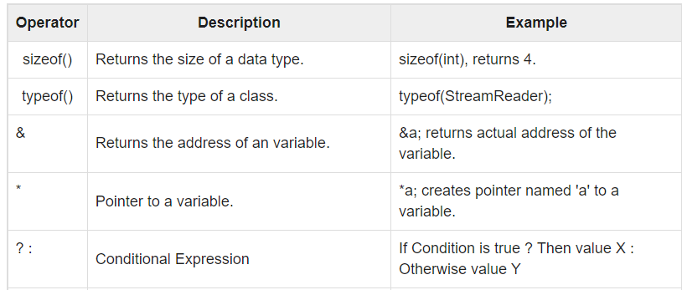
Miscellaneous Operators
Conditional Expression example
int input = new Random().Next(-5, 5);
string classify;
if (input >= 0)
{
classify = "nonnegative";
}
else
{
classify = "negative";
}
classify = (input >= 0) ? "nonnegative" : "negative";

Slide 22
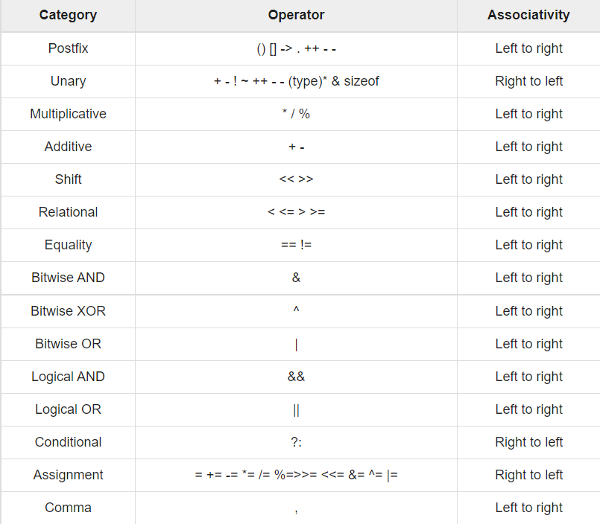
Operators Precedence in C#

Slide 23
Control Structures
There are main three types of Control Structures which are as follows:
Selection (This consists of if, else, switch, and case branching).
Iteration (This consists of do, for, foreach, and while looping).
Jumps (This consists of break, continue, return, and goto statements).

Slide 24
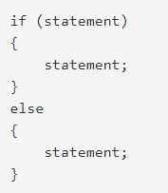
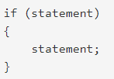
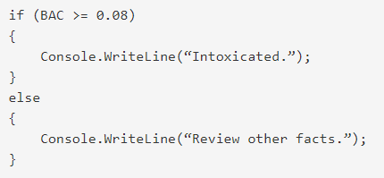
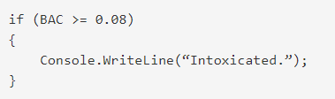
Control Structures (Selection)
If, If Else Statement

Slide 25
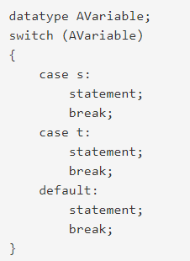
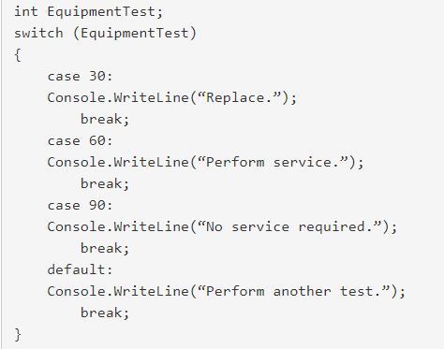
Control Structures (Selection)
Switch Statement

Slide 26
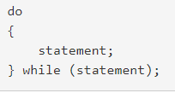

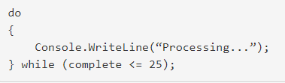
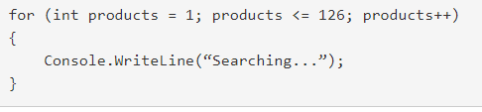
Control Structures (Iteration)

Slide 27
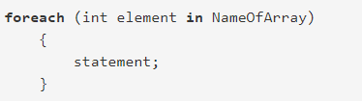
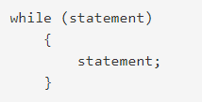
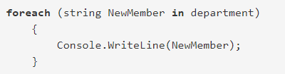
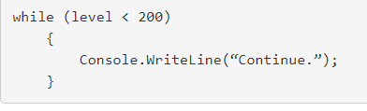
Control Structures (Iteration)

Slide 28
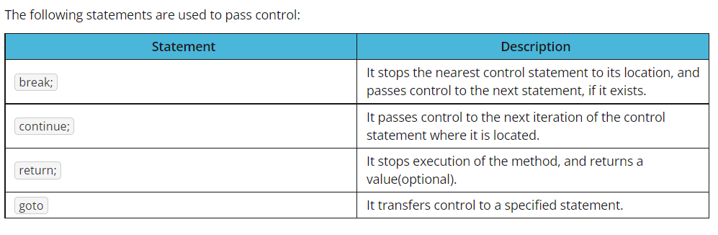
Control Structures (Jump)

